Slide 1
Making an impression

Slide 2
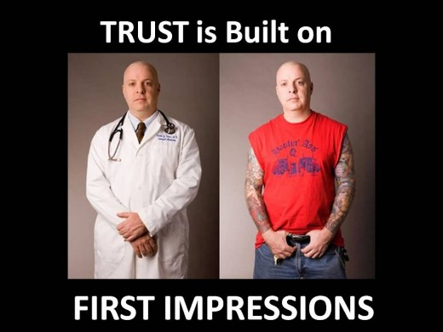
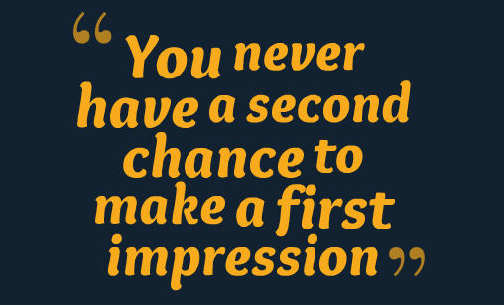
Why making a good impression is important?

Slide 3


Phone interview
Personal interview

Slide 4
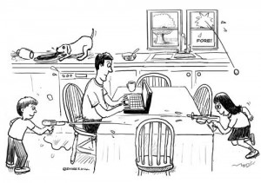

During phone interview
Eliminate distractions

Slide 5


During phone interview
Have reference materials nearby

Slide 6





During phone interview
Focus, listen and enunciate

Slide 7

During phone interview
Be all smiles

Slide 8

Personal interview

Slide 9
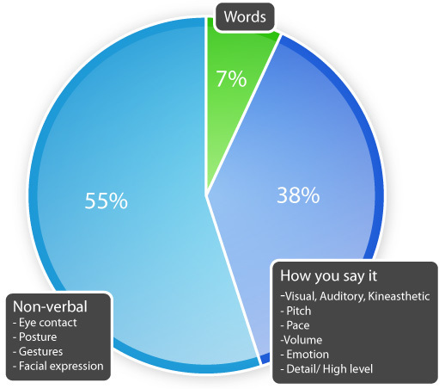
Non-verbal communication
93%

Slide 10





Before personal interview
Dress appropriately
Bring only the essentials, organize to be accessible
Show up on time
Do a Pre-Interview Body check, put phone away

Slide 11
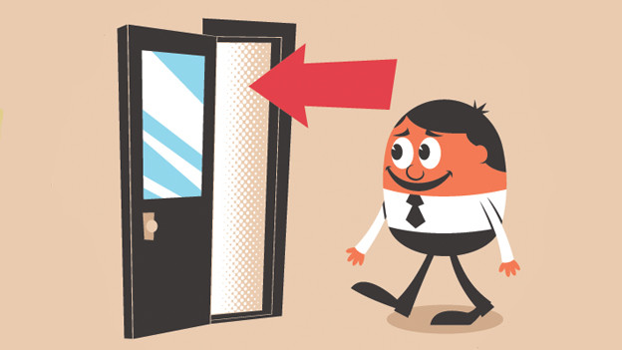
During personal interview
Entering confidently

Slide 12

During personal interview
Handshake and eye contact

Slide 13

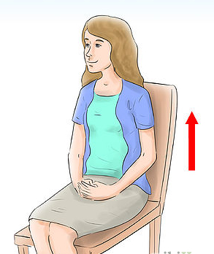
During personal interview
Posture and gesture

Slide 14
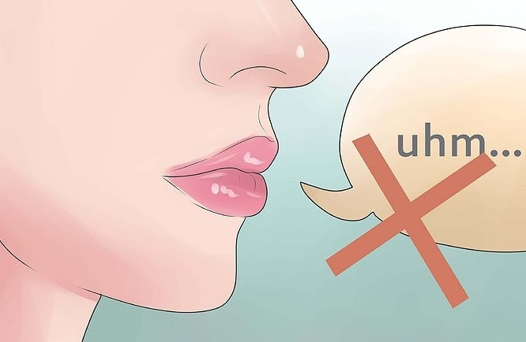

During personal interview
Speak clearly and confidently
Match the frequency

Slide 15
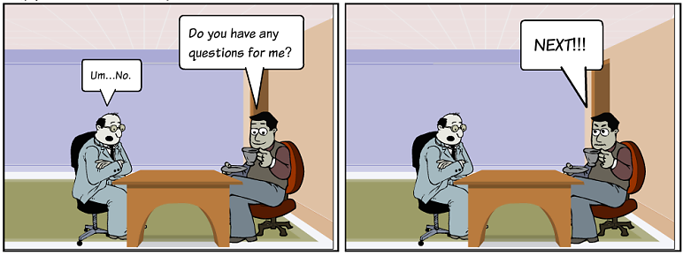

During personal interview
Ask questions
Thanks to the interviewer

